Slide 1
Finding the Perfect Place to Live
A Case Study: Finding an affordable rental property in the San Francisco area that meets certain client requirements

Slide 2
The Clients Request
Under $5000/ month
Low Crime Area
Access to a Bar and Coffee Shop
Frequently visited Business Establishments

Slide 3
The Data
Crime Statistics for San Francisco Neighborhoods
https://s3-api.us-geo.objectstorage.softlayer.net/cf-courses-data/CognitiveClass/DV0101EN/labs/Data_Files/Police_Department_Incidents_-_Previous_Year__2016_.csv
A GeoJSON file with clear Neighborhood Boundaries
https://cocl.us/sanfran_geojson

Slide 4
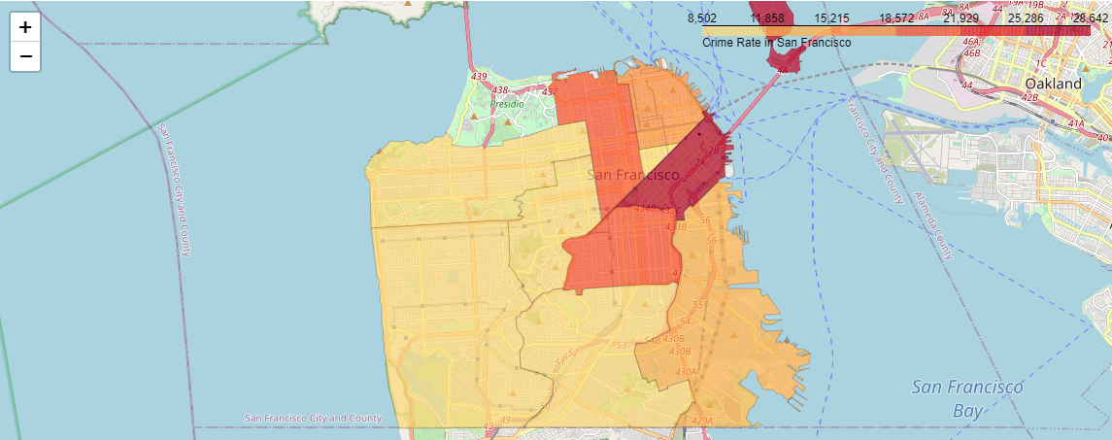
Methodology
Develop a Cloropleth map of Crime Data

Slide 5
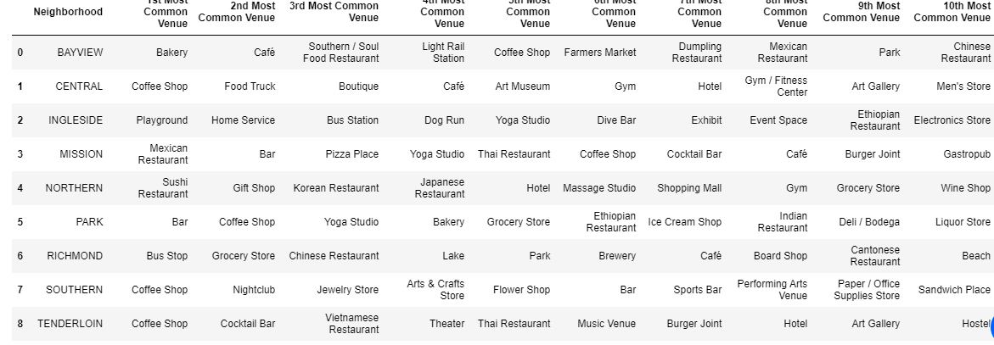
Methodology
Venue Data for each Neighborhood

Slide 6
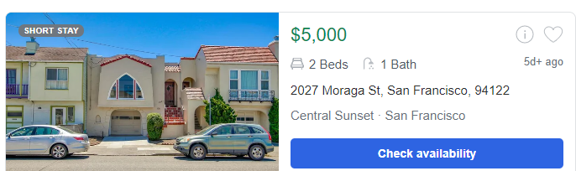
Properties

Slide 7
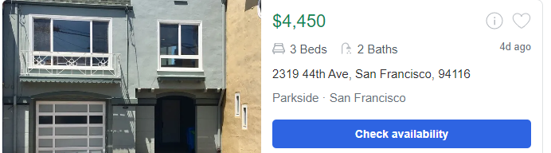
Properties

Slide 8
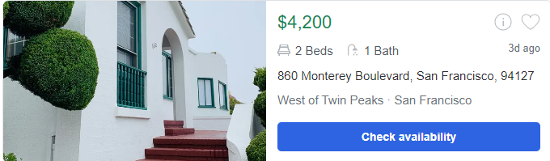
Properties

Slide 9
Conclusion
Parameters can be adjusted to fit client desires
Location can be adjusted to accommodate any available data set
Any map type can be used
Clusters could be added

